Slide 1

DATA SOURCE COMBINATION FEDERAL AVIATION ADMINISTRATION

Slide 2





TEAM IMMORTALS
Vishnu Nimallapalli SCRUM MASTER
Sai Shashank Vinnakota DEVELOPER
Krishna Chaitanya Ashish Vattem PRODUCT OWNER
Dhruveeth Pabba DEVELOPER
Sai Gaurav Daula DEVELOPER

Slide 3

FEDERAL AVIATION ADMINISTRATION
The Federal Aviation Administration (FAA) is the largest modern transportation agency and a governmental body of the United States with powers to regulate all aspects of civil aviation in that nation as well as over its surrounding international waters

Slide 4
Problem Statement
Multiple data sources are acquired by the federal aviation administration (FAA) and record the aircraft incidents, accidents or failure.
The datasets were created with different perspectives of the individuals creating them, which are specific to their business objectives.
The main aim is to map the data from the multiple data sources and create a single repository which can be readily available for the FAA.
Efficient data insights can be built using the data Engineering techniques which must be applied throughout this project.

Slide 5
ROADMAP
Dataset Aquisition
NLP Techniques
Machine Learning models
1
3
5
2
4
6
Data Pre-Processing
Merging Techniques
Results & Findings

Slide 6
DATASETS OVERVIEW
1. Service Difficulty Reports
Dataset Owner: Federal Aviation Administration (FAA)
Dataset Year: 2019
Dataset Type: Open Source
Dataset License: FAA
2. Accident/Incident Data
Dataset Owner: Federal Aviation Administration (FAA) AIDS data
Dataset Type: Open Source
Dataset Year: 2019
Dataset License: FAA
3. Aviation Safety Reporting System
Dataset Owner: Federal Aviation Administration (FAA)
Dataset Type: Open Source
Dataset Year: 2019
Dataset License: FAA

Slide 7
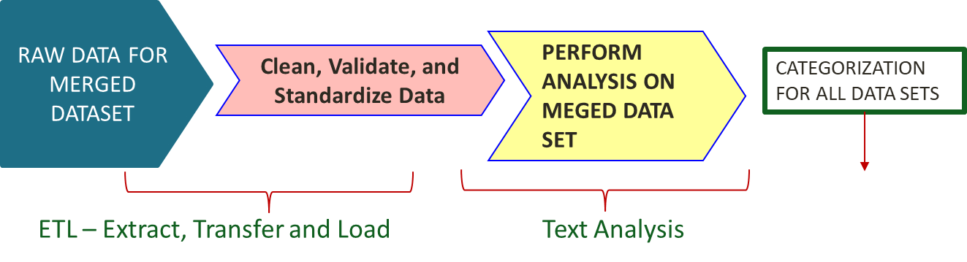
Concept - 1
GROUPED DATASET

Slide 8
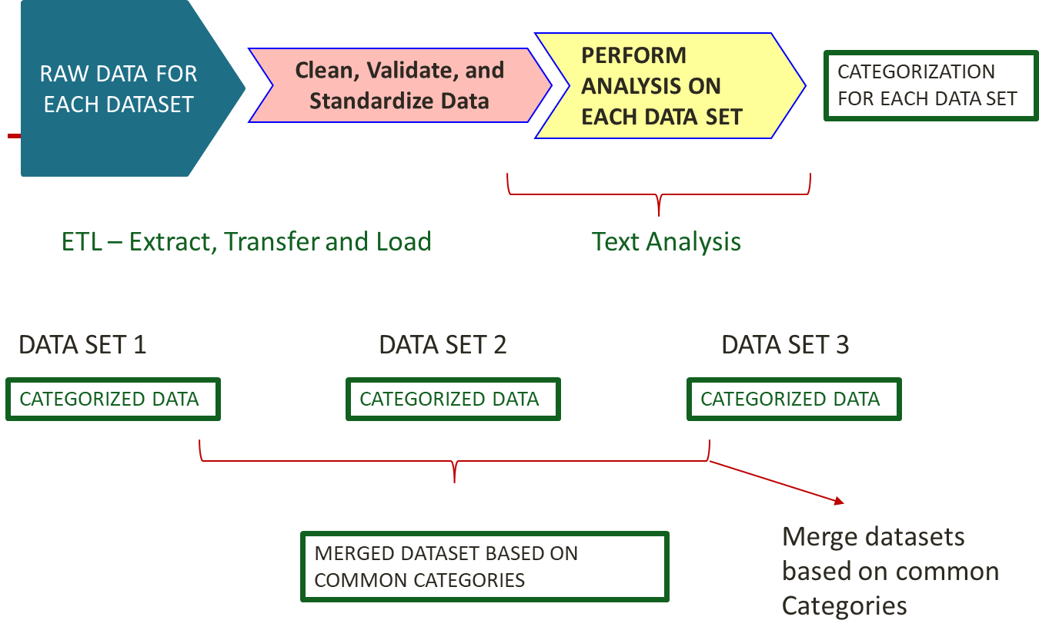
Concept - 2

Slide 9
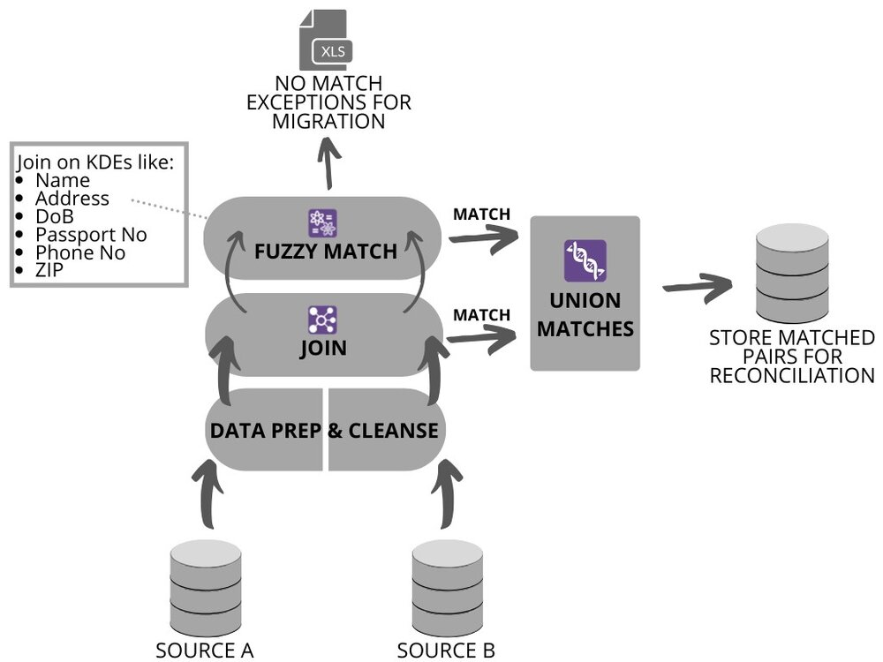
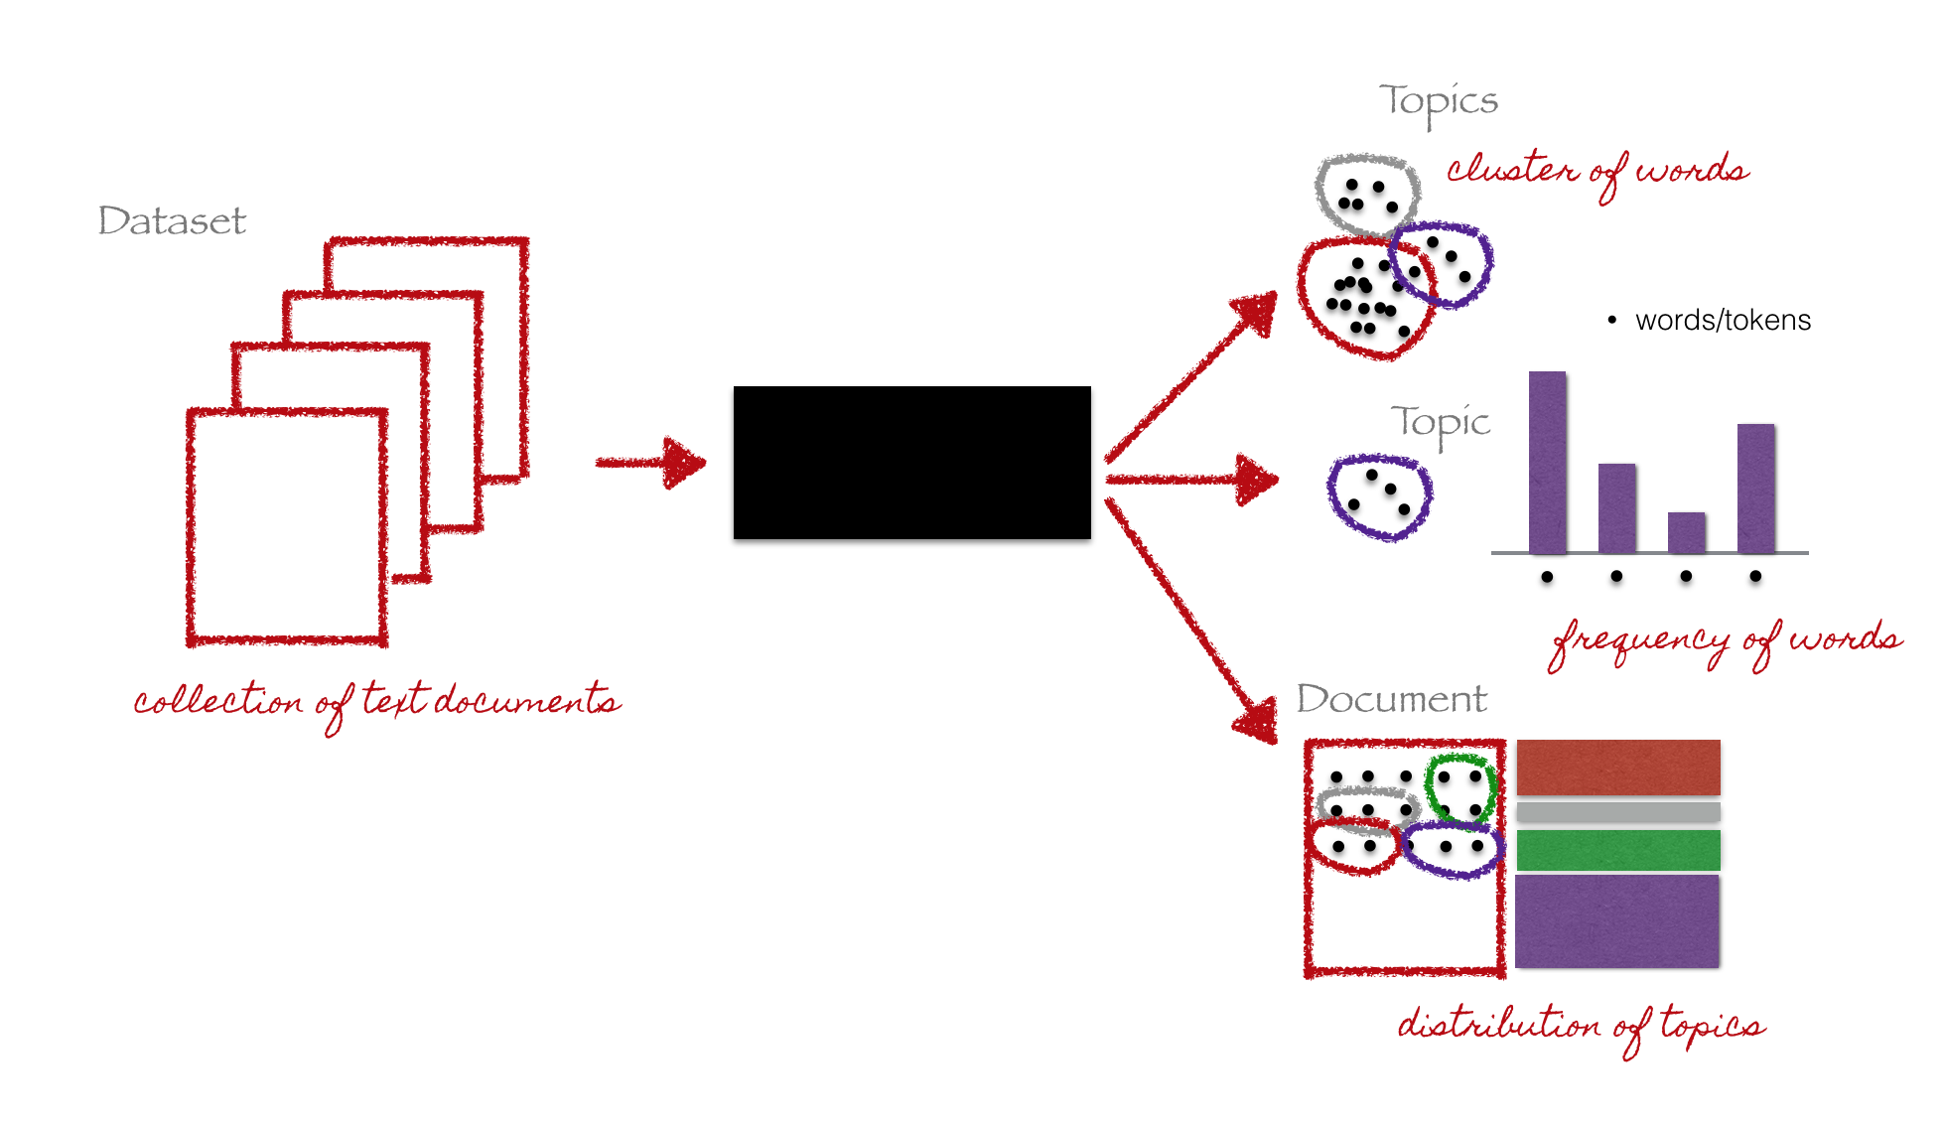
APPROACH
TOPIC MODELLING
In natural language processing, the latent Dirichlet allocation (LDA) is a generative statistical model that allows sets of observations to be explained by unobserved groups that explain why some parts of the data are similar.
FUZZY MATCHER
This has a very simple interface to link two data frames in pandas using probabilistic record linking. The main plus point for this it gives a ratio score which is nothing but the best match score for the value/ row .

Slide 10
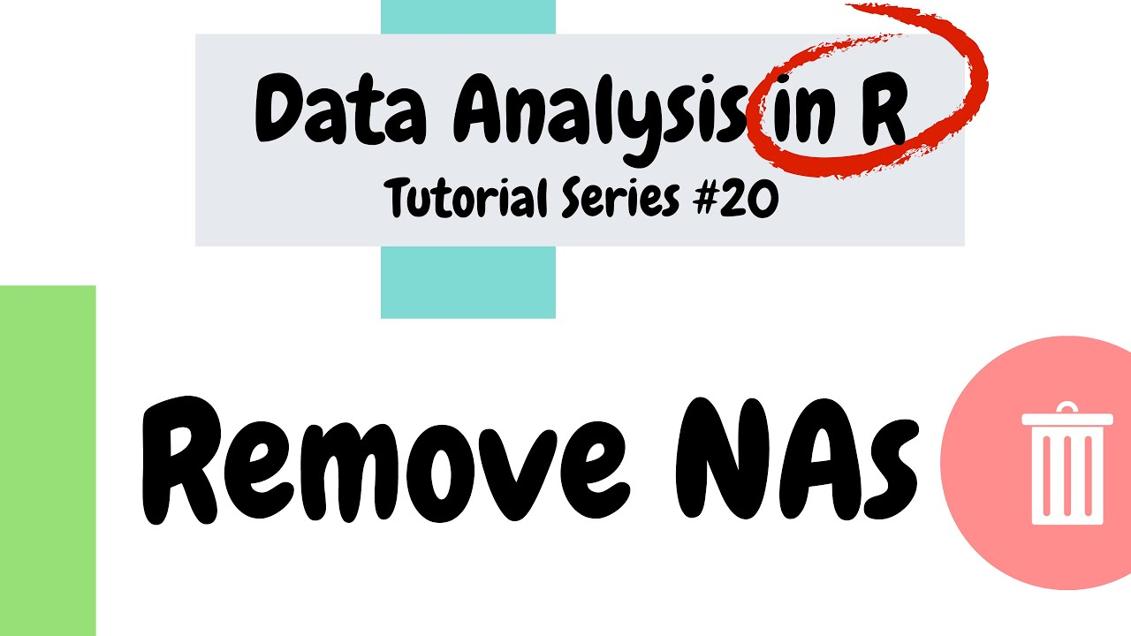
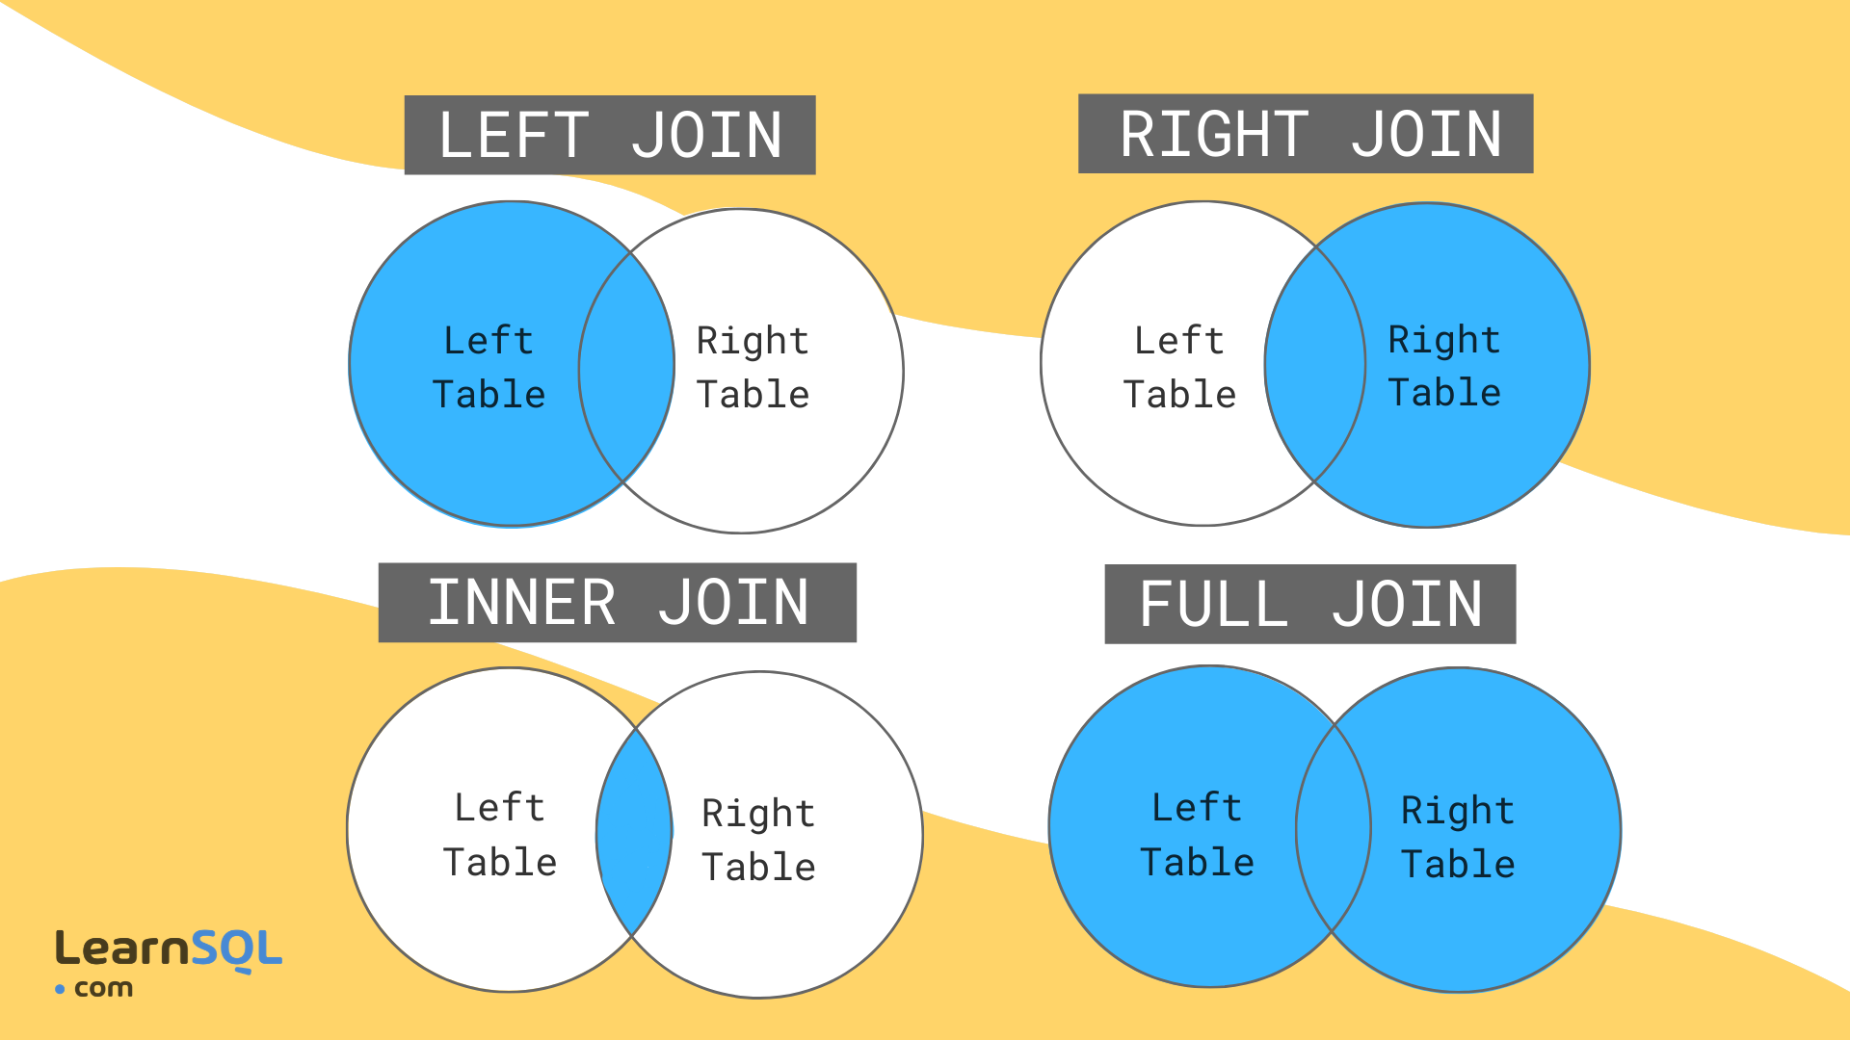
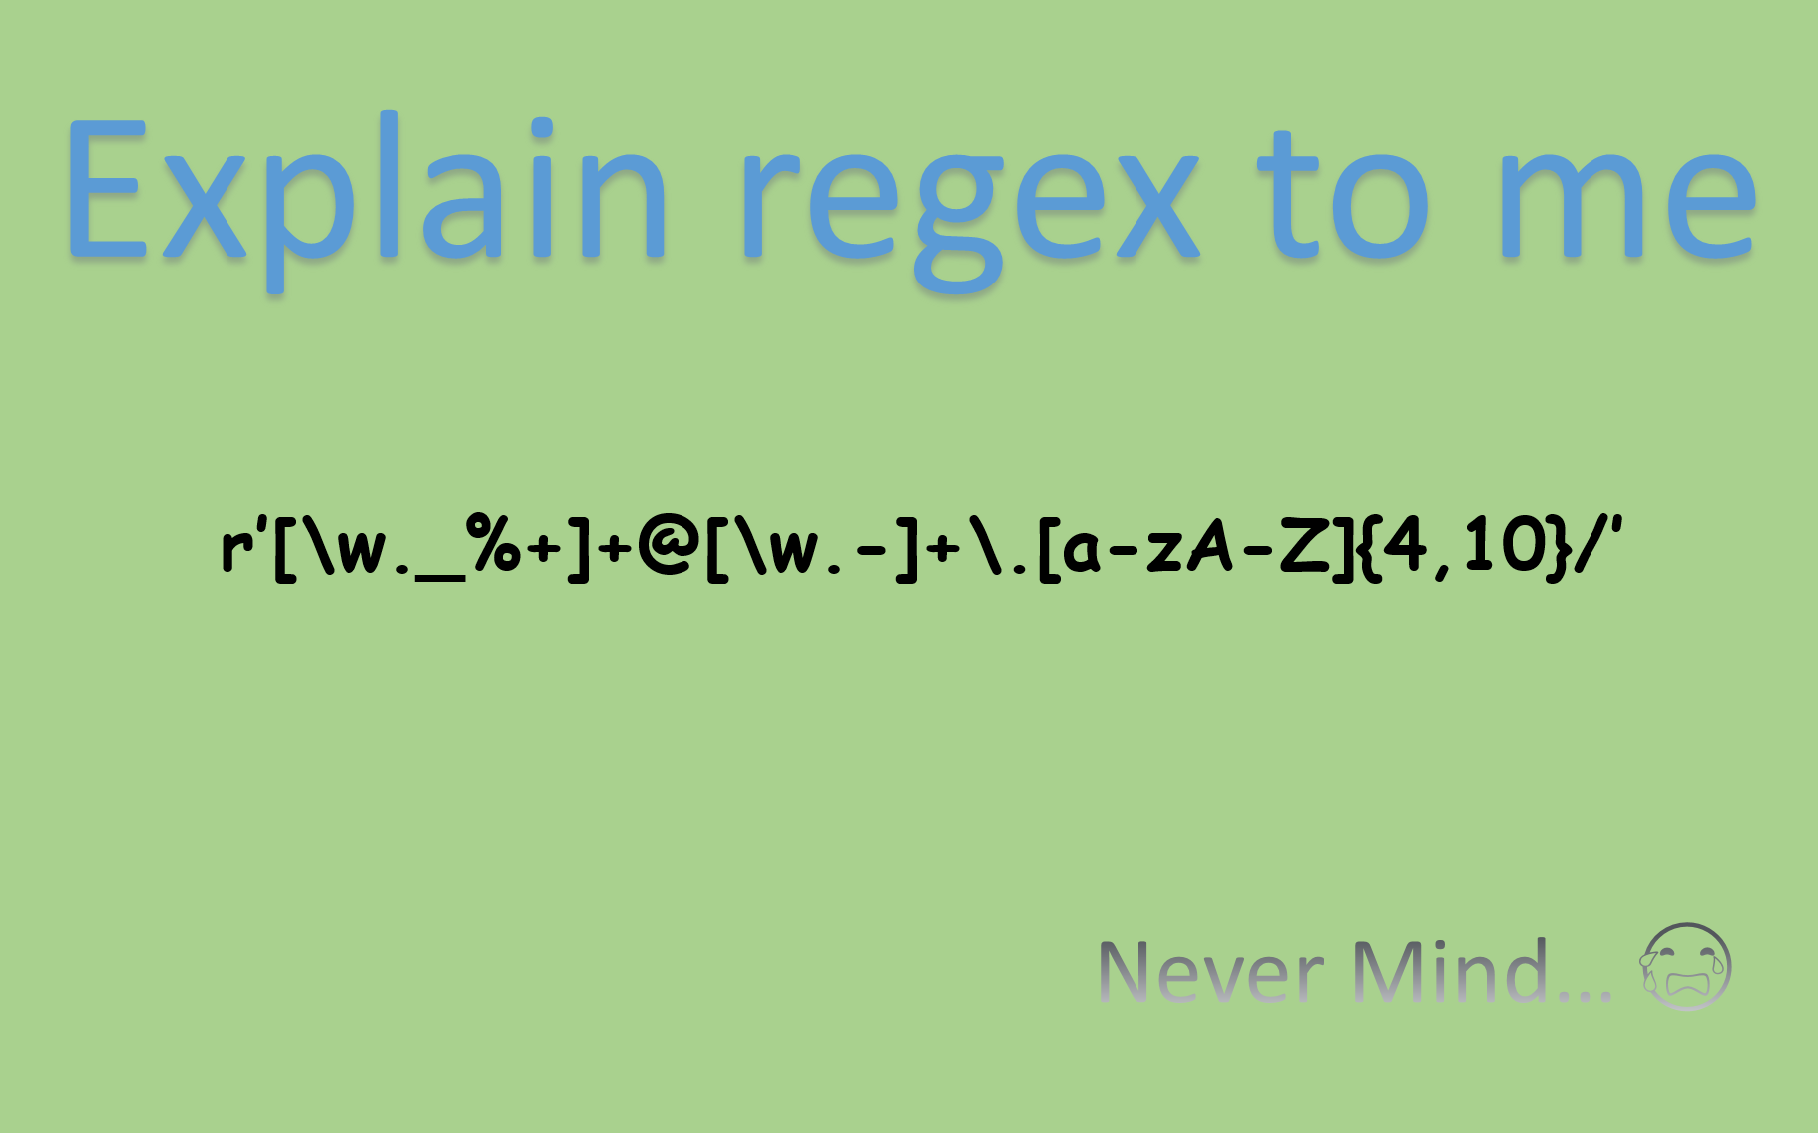
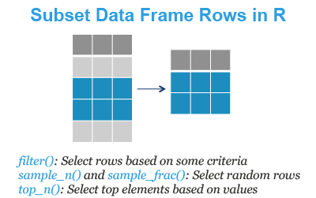
DATA PRE-PROCESSING
DATA DUPLICATION REMOVAL
NA REMOVAL
DATA TYPES FORMATTING
RENAMMING COLUMNS
REGEX
SUBSETTING
JOINS

Slide 11

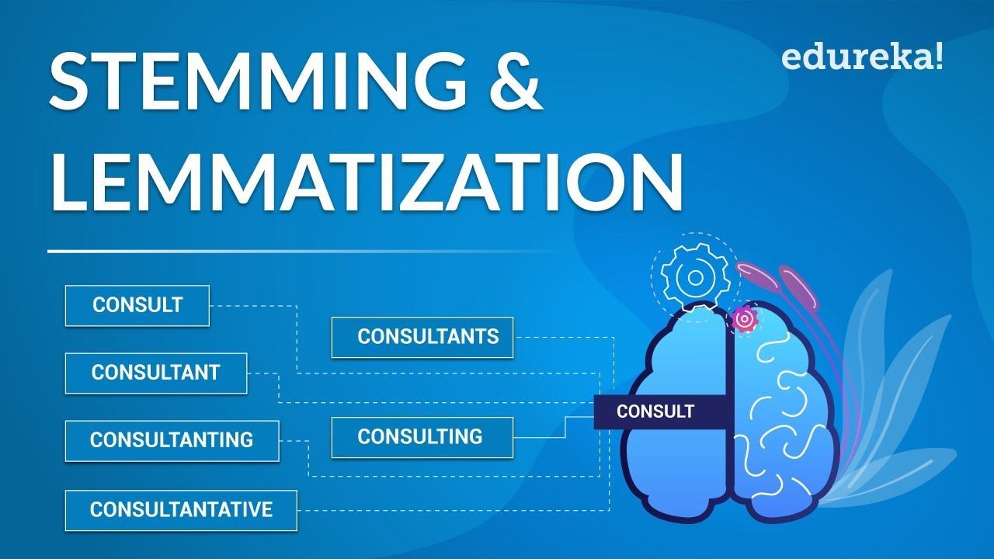
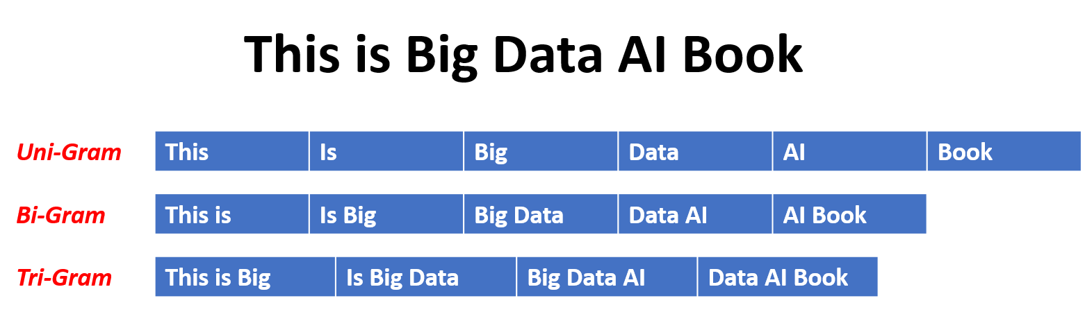
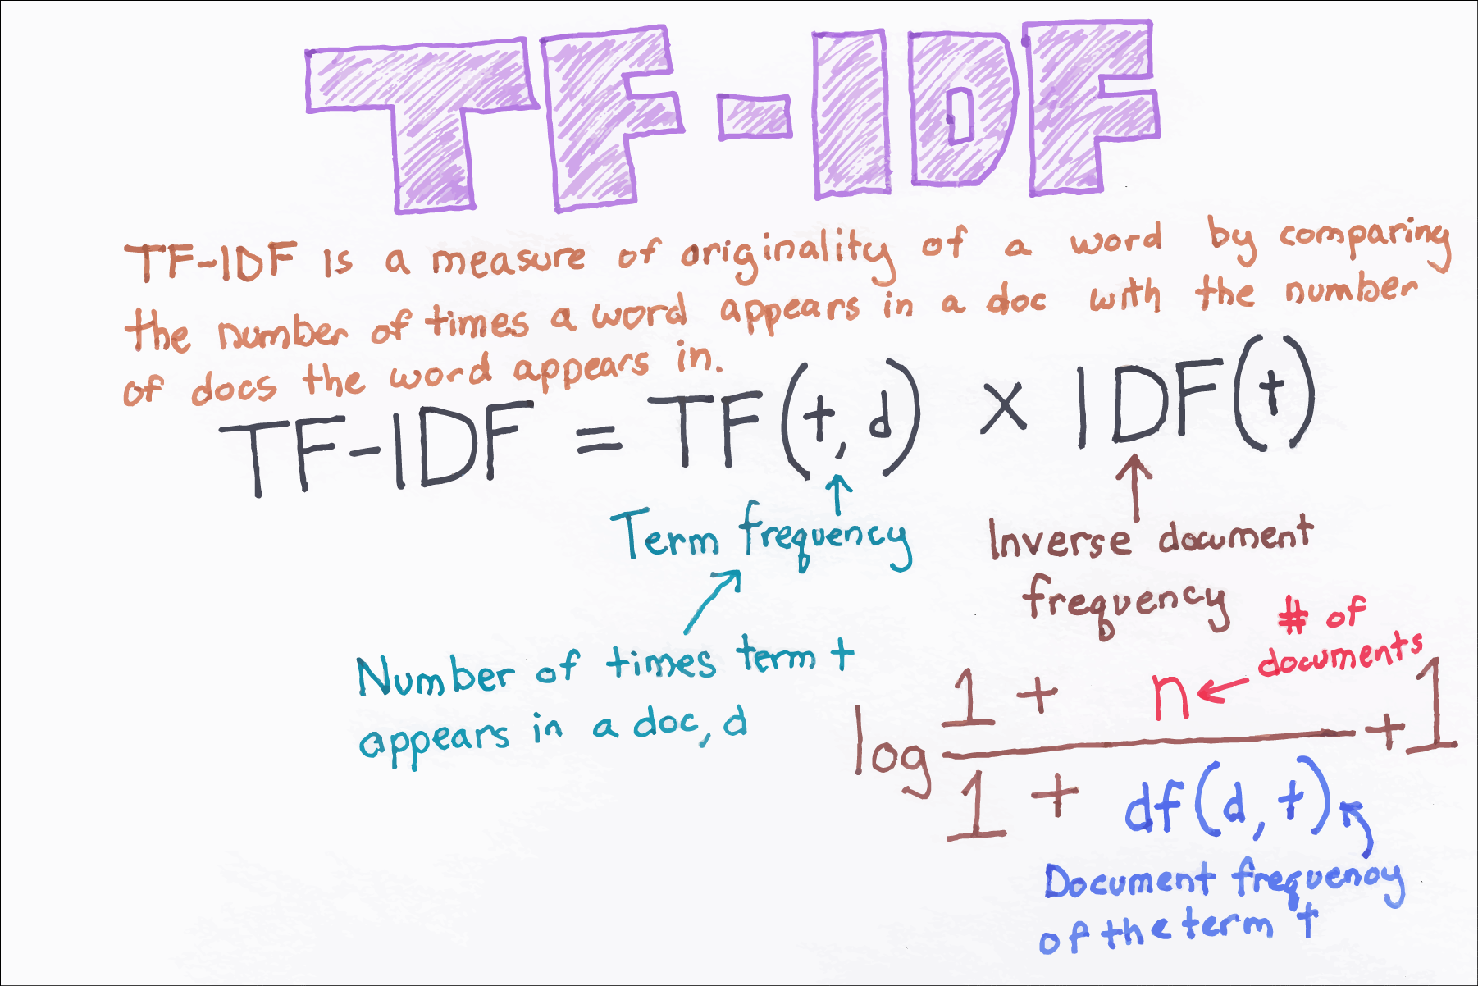
DATA PRE-PROCESSING - NLP
STOP WORDS REMOVAL
LEMMATIZATION
N-GRAMS
TF-IDF VECTORIZER
REGEX
FEATURE EXTRACTION

Slide 12
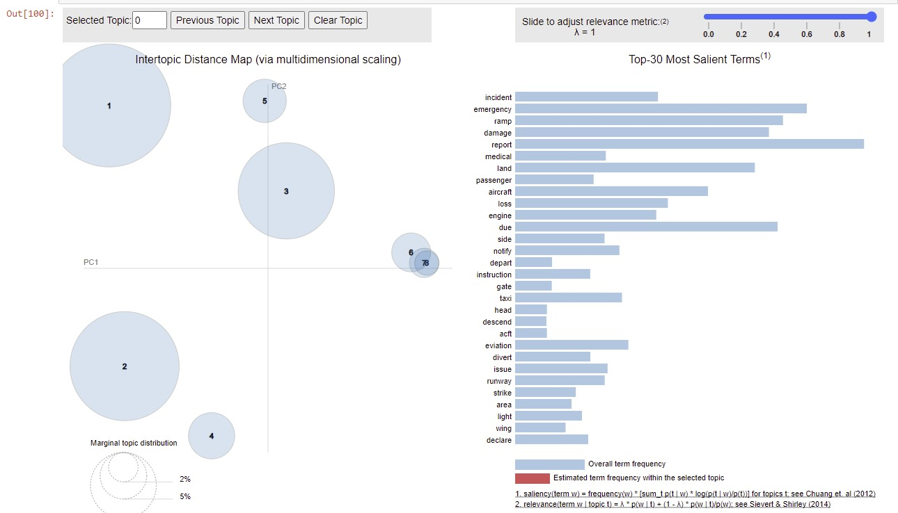
TOPIC MODELING
LDA TOPIC MODEL 8 TOPICS

Slide 13
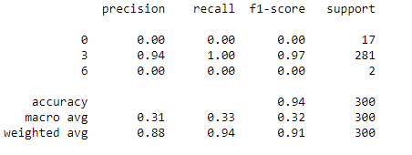
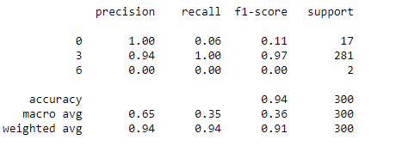
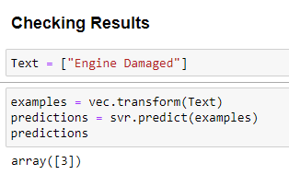
MACHINE LEARNING MODELS AND RESULTS
NAÏVE BAYES
RANDOM FOREST

Slide 14
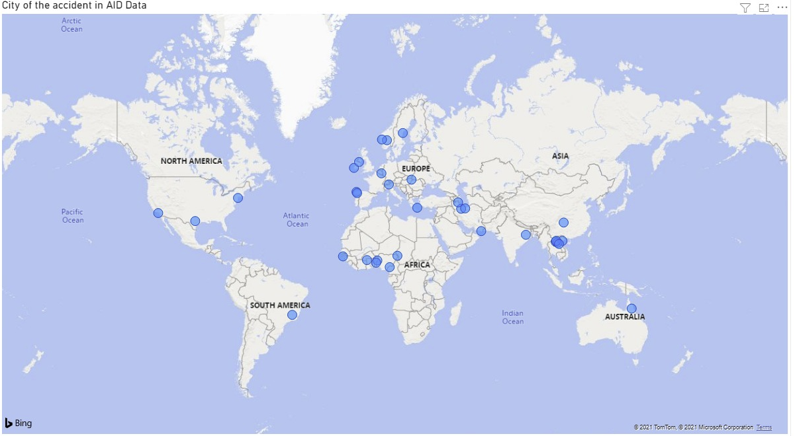
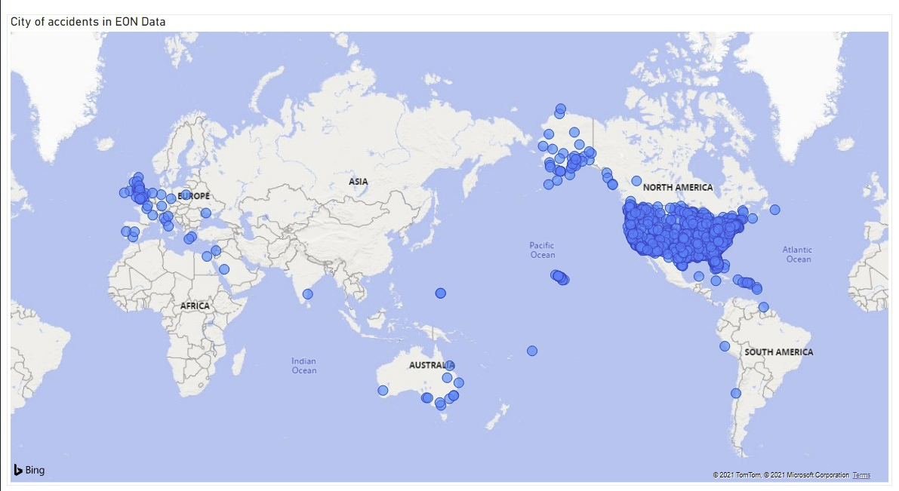
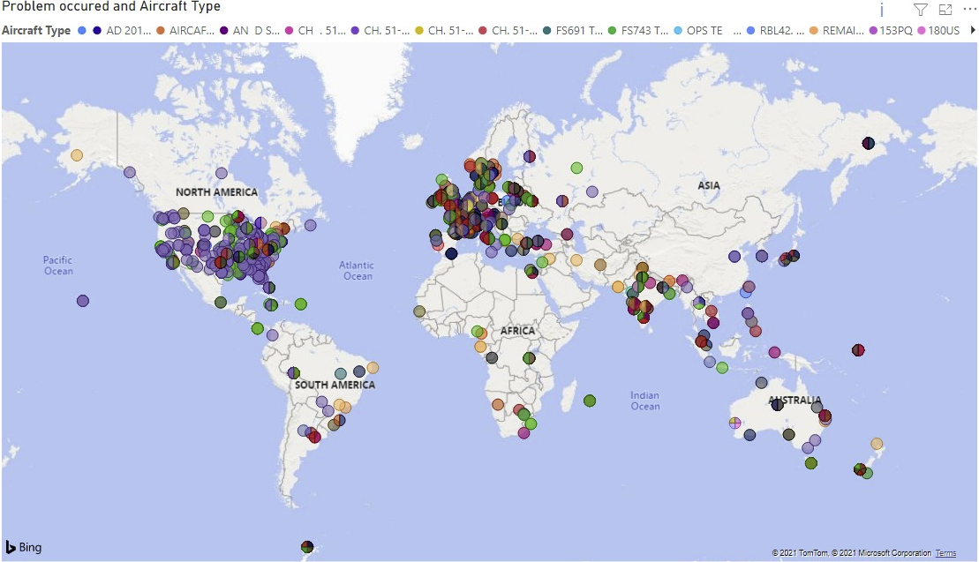
WORLD MAPS

Slide 15
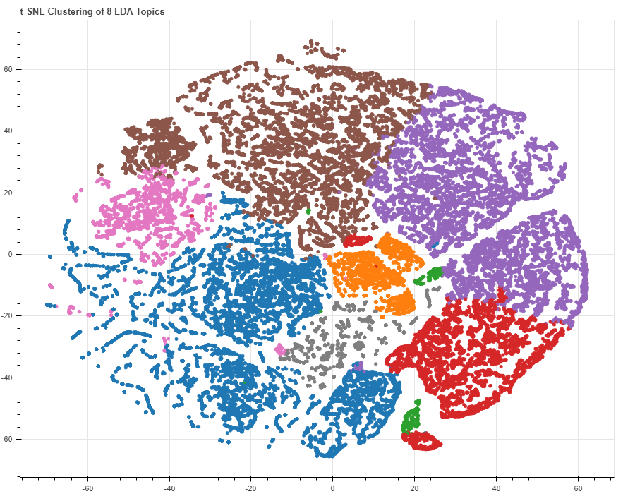
CLUSTERING OF TOPICS

Slide 16
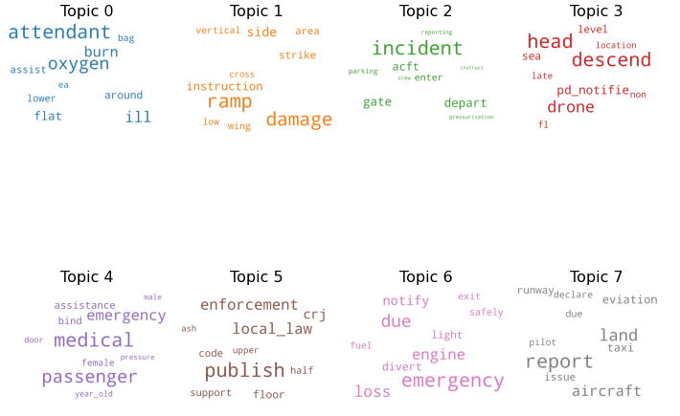
WORD CLOUD

Slide 17
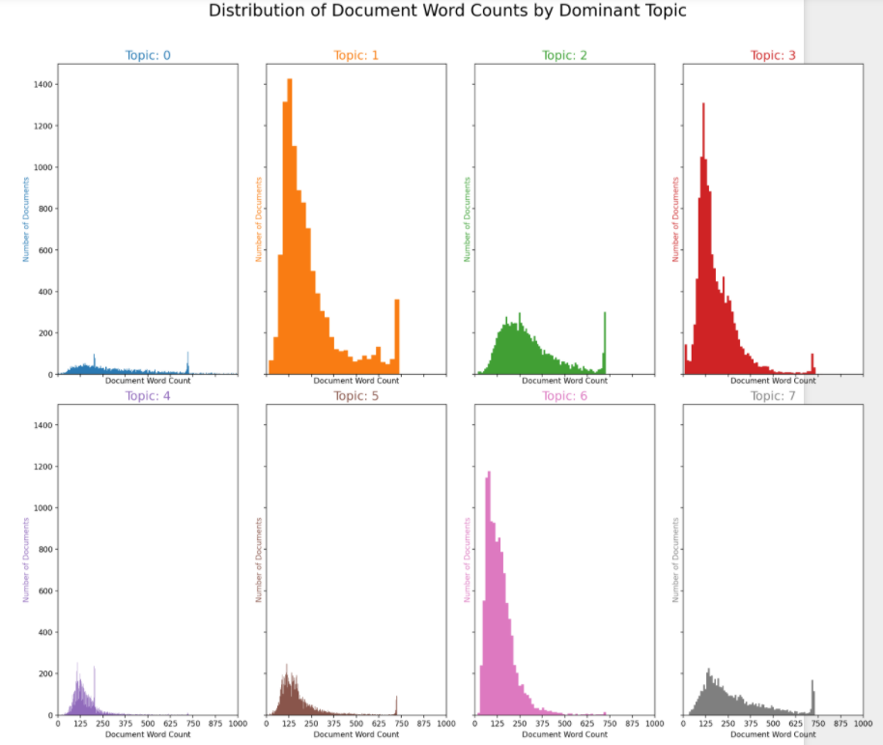
WORD DISTRIBUTION

Slide 18
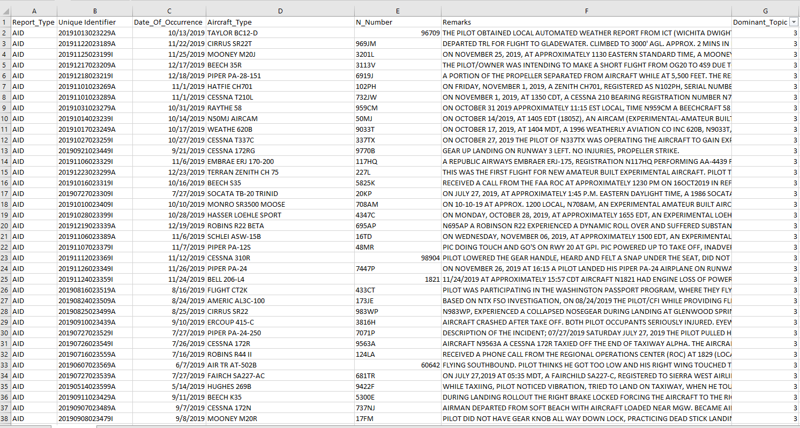
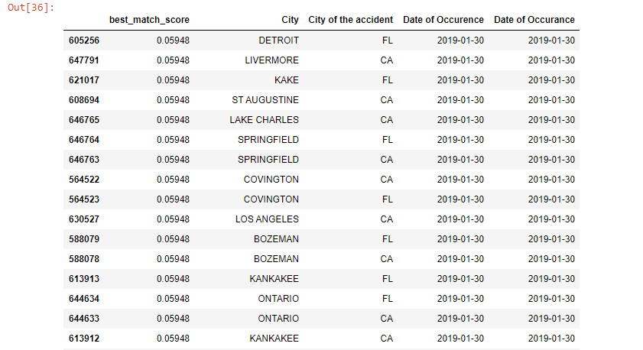
TOPIC MODELING
FUZZY MATCHING

Slide 19
RESULTS
FUTURE STUDY
FUZZY MATCHING HAS GIVEN REULTS THAT HAVE PARTIAL MATCHING AND THE PROBABILITY FOR THEM TO MATCH IS 60%
SOME AUTOMATIONS CAN BE DONE IN ORDER TO MAKE THE PROCESS SIMPLER AND FASTER.
TOPIC MODELING HELPED CATEGORIZING THE DATA BASED ON FEW KEY WORDS AND THAT HELPED THE RECORDS TO BE CATEGORIZED AND GROUPED WITH 93% ACCURACY
ADVANCED NLP TECHNIQUES CAN HELP GETTING RID OF FEW OVERLAPPING DATA IN TOPIC MODELING.
CLEANER DATASETS RECEIVED COULD LEAD TO BETTER RESULTS AND BETTER CLASSIFICATION.
BOTH THE MODELS HAVE PERFORMED WELL AND GIVEN GOOD RESULTS
MACHINE LEARNING MODELS WOULD HELP FAA PREDICT WHICH CATEGORY THE NEW DATA WOULD BE CLASSIFIED INTO.
MERGING THE DATA BASED ON WEIGHTAGE OF IMPORTANCE CAN BE ADDED TO THE MODELS.

Slide 20
THANKS!
Any questions?
You can find us at
vinnakota.shashank@gmail.com
saigauravdaula@gmail.com
dhruveeth07@gmail.com
vishnunimmalapallicap@gmail.com
ashishvattem@gmail.com

